Slide 1
A New Method for Fall Detection of Elderly Based on Human Shape and Motion Variation
Abderrazak Iazzi, Mohammed Rziza, Rachid Oulad Haj Thami, and Driss Aboutajdine
International Symposium on Visual Computing ISVC 2016

Slide 2
abstract
the person shape -> three blocks extracted from rectangle
using thresholding-based method

Slide 3
introduction
computer-vision-based fall detection system
use scene analysis to identify a laying posture
vector analysis to identify abnormal motion

Slide 4
Related Work
extracted from the three points (centroid of upper, middle and lower human part)
fall detection through SVM and AdaBoost classiﬁcation

Slide 5
Online one class Support Vector Machine (OCSVM) Model
-distinguish a normal posture from an abnormal posture

Slide 6
The Principal Module of Fall Detection System
(i) video capture
(ii) Detection Moving Object
(iii) Features Extraction and
(iv) Recognition Behavior and fall detection.

Slide 7
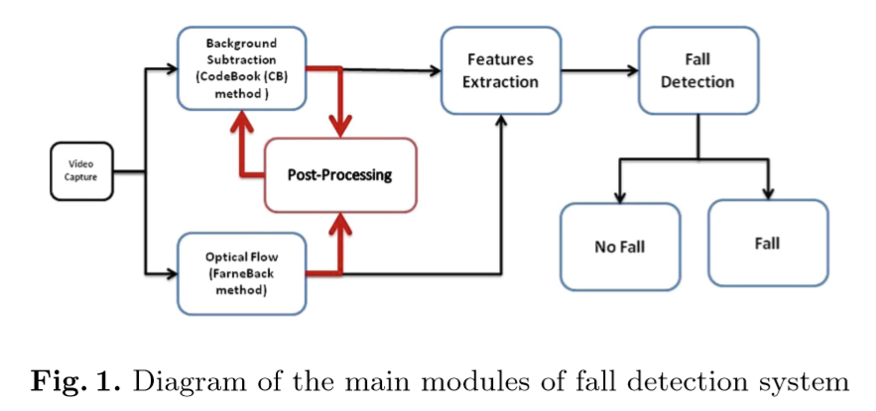

Slide 8
Background Subtraction
use the CB(codebook) method
capability of removing shadows
->>Distinguish person from background
BS results obtained contain diﬀerent noisy artifacts

Slide 9
Post-Processing
result obtained is not always satisfying in general
BLOB-merging : a number of pixels of their area less than a threshold should be removed. Ex) 50px
Determining the Human Silhouette : two objects have nearly the same number of moving pixels
Notes:
the smallest distance between its position (center of gravity) and the last recorded position of the person.

Slide 10
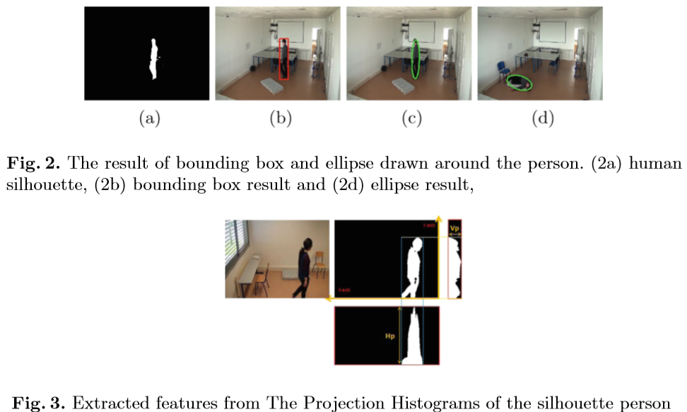

Slide 11


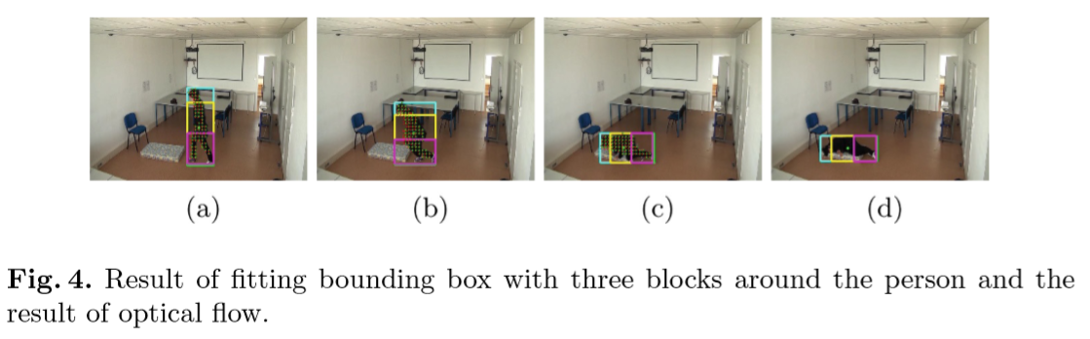
compute the person’s velocity
three blocks based on the width and height

Slide 12
Fall Detection
The abnormal event is characterized by a sudden change in velocity and shape
the normal activities take more time

Slide 13
Experimental Results
Dataset is composed of 219 videos, including diﬀerent activities, 95 videos of normal activities and 124 videos of fall activities

Slide 14
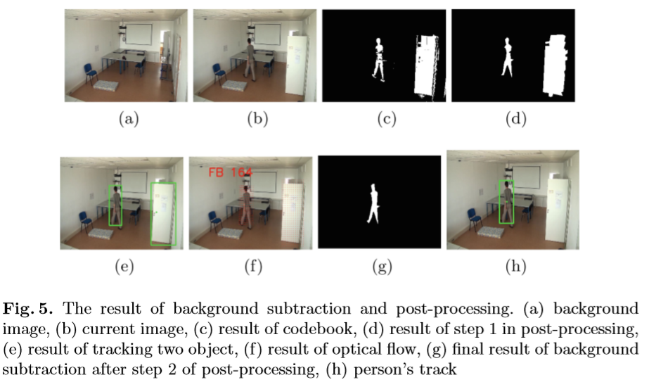
Background Subtraction Results

Slide 15
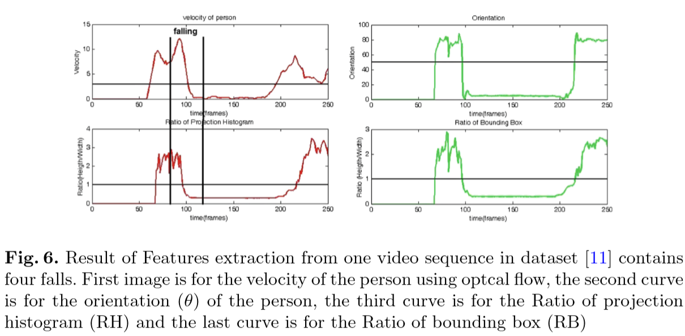
Feature Analysis and Fall Detection
Between 3 boxes
Width / height

Slide 16
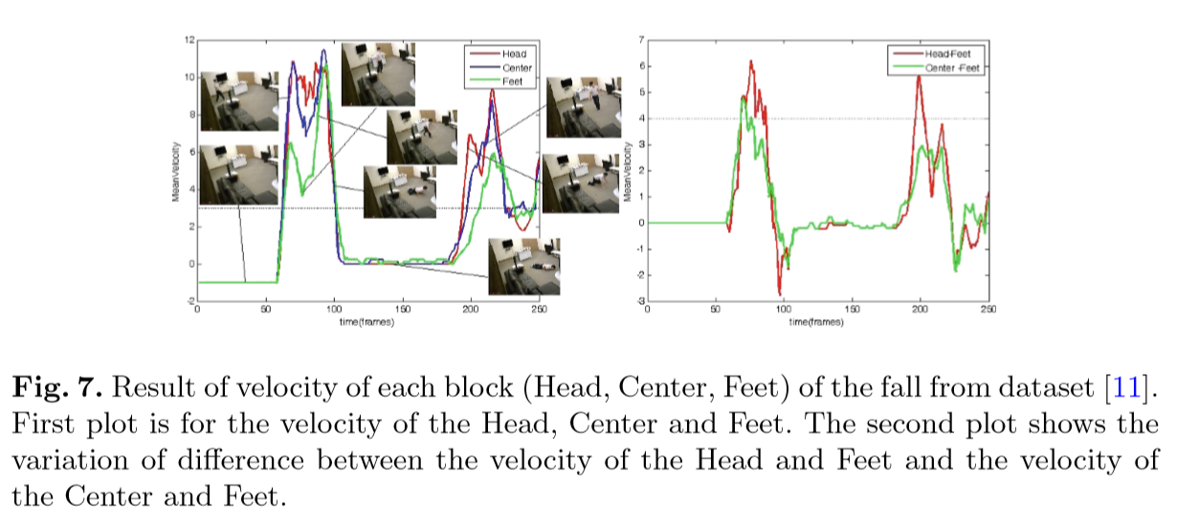

Slide 17
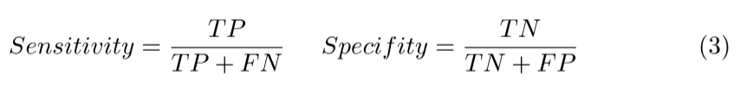
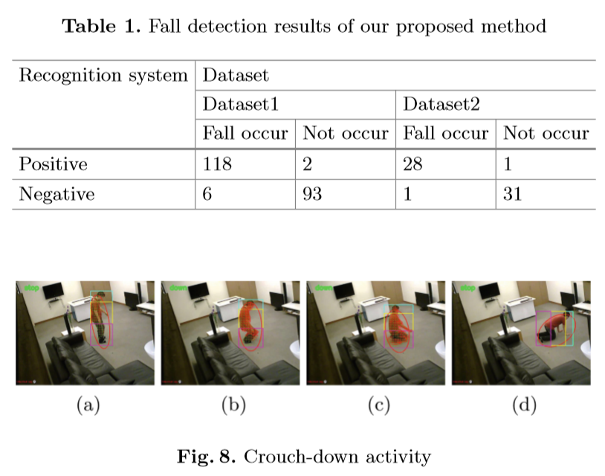
Performance of Our Fall Detection System
TP FALL > DETECT
FP FALL > NOT DETECT
TN NOT FALL > NOT DETECT
FN NOT FALL > DETECT

Slide 18
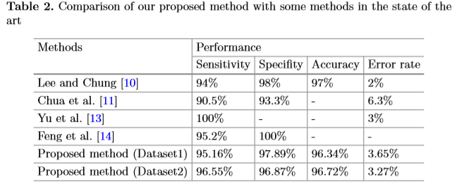

Slide 19
Conclusion and Discussion
need to improve the background subtraction
-> only rely on the motion and the distance between objects
only made under good lighting conditions
depends on the best thresholds used to detect a fall

